Slide 1

Data Integration and Large Scale Analysis 04 Schema Matching and Mapping
Slides Credit: Matthias Boehm
Last update: Nov 08, 2024

Slide 2
Agenda
Project Descriptions
Motivation and Terminology
Schema Detection
Schema Matching
Schema Mapping

Slide 3
Project Descriptions

Slide 4
Student Projects
Project Descriptions
SystemDS
https://issues.apache.org/jira/browse/SYSTEMDS-3780?filter=12350169
Daphne
https://github.com/daphne-eu/daphne/issues?q=is%3Aissue+is%3Aopen+label%3A%22student+project%22
Contact person: Dr. Lucas Iacono <Iiacono@tugraz.at>

Slide 5
Team Projects
Project Descriptions
#1 Data Analysis Pipeline for Weather Data and Deploy it on Cloud
Goal: to provide insights about thermal inversion on Austrian Farms using weather data collected with a sensor tower and a weather station (real data)
Develop a pipeline including data collection, preparation, analysis, modeling, model deployment and results provisioning
Use public cloud services (AWS, Google or Azure) to perform the data cleaning and inspection, and to compute the required analytics
Detect thermal inversions in the lower layers of the atmosphere above the farm in the frost season
Merge the data from the sensor tower with the dataset from the weather station to train and evaluate a DL model to predict minimum temperature in the location of the tower
#2 Data Analysis Pipeline for Motor Sports Data and Deploy it on Cloud
F1 data but to predict the fastest lap times from the sector times

Slide 6
Motivation and Terminology

Slide 7
Recap: ETL/EAI Schema Transformations
Motivation and Terminology
<?xml version="1.0" encoding="UTF-8"?>
<xsl:stylesheet version="2.0“ xmlns:xsl="http://www.w3.org/1999/XSL/Transform">
<xsl:template match="/">
<xsl:element name=“suppliers">
<xsl:for-each select="/resultsets/resultset[@Tablename='Supplier']/row">
<xsl:element name=“supplier">
<xsl:attribute name=“ID"><xsl:value-of select="Suppkey"/></xsl:attribute>
<xsl:element name="Name"><xsl:value-of select="SuppName"/></xsl:element>
<xsl:element name="Address"><xsl:value-of select="SuppAddress"/></xsl:element>
</xsl:element>
</xsl:for-each>
</xsl:element>
</xsl:template>
</xsl:stylesheet>
Are you kidding me? I have 100s of systems/apps and 1000s* of tables/attributes
<resultssets>
<resultset Tablename=“Supplier”>
<row>
<Suppkey>7</Suppkey>
<SuppName>MB</Suppname>
<SuppAddress>1035 Coleman Rd</SuppAddress>
</row>
<row> … </row>
</resultset>
</resultsets>
<suppliers>
<supplier ID=“7”>
<Name>MB</Name>
<Address>1035 Coleman Rd</Address>
</supplier>
<supplier> … </supplier>
<suppliers>
* [Rudolf Munz: Datenmanagement für SAP Applikationen, BTW, 2007: 67,000 tables, 700,000 columns, 10,000 views, 13,000 indexes]

Slide 8

Schema Matching and Mapping
Motivation and Terminology
Schema Matching
Given: two or more relational/hierarchical schemas (and data)
Find schema mappings in terms of logical attribute correspondences
Schema Mapping
Given: logical attribute correspondences between schemas
Compile physical schema mapping programs (SQL, XSLT, XQuery, etc)
Well, I don’t even have a schema
Schema Detection
Schema Matching
Schema Mapping
INSERT INTO Orders SELECT BELNR, SUMME, DATUM FROM Bestellungen

Slide 9
Schema Mapping vs. Schema Integration
Motivation and Terminology
Schema Integration
Use case: DWH schema (lecture 02), virtual/federated DBMS (lecture 03)
Schema integration: map existing schemas into consolidated schema
Schema mapping orthogonal, but both deal with semantic and structural heterogeneity
Integrated Schema
Schema Mapping
Schema Mapping
2
4
1
3
DWH
Schema 1
Schema 2
2
2
4
1
3
Schema Mapping
3
Source 1
Source 2

Slide 10
Recap: Types of Heterogeneity ➔ Scope
Motivation and Terminology
[J. Hammer, M. Stonebraker, and O. Topsakal: THALIA: Test Harness for the Assessment of Legacy Information Integration Approaches. U Florida, TR05-001, 2005]
Heterogeneity
Semantic Heterogeneity
Structural Heterogeneity
Attribute Heterogeneity
Missing Data
1. Synonyms/homonyms
6. Nulls (Missing Values)
9. Same attribute in different structure
2. Simple mapping (mathematical)
7. Virtual columns
8. Semantic incompatibility
10. Handling Sets
3. Different data types
11. Attribute name w/o semantics
4. Complex mappings
5. Language expressions
12. Attribute composition

Slide 11
Schema Detection
Schema Detection
Schema Matching
Schema Mapping
INSERT INTO Orders SELECT BELNR, SUMME, DATUM FROM Bestellungen

Slide 12

Atomic Data Type Detection
Schema Detection
Overview
Problem: Given CSV, JSON, XML files, detect data types of attributes
Approach: Basic extraction rules, regular expressions over data sample
Example: Schema Inference
Infer schema for dataframe/dataset columns from sample
Basic types: Decimal, Boolean, Double, Integer, Long, String
Infer schema from java objects via class reflection
./data/players.csv:
pid,name,pos,jnum,ncid,tid
4614,Hannes Reinmayr,FW,14,1313,258
5435,Miroslav Klose,FW,11,789,144
6909,Manuel Neuer,GK,1,163,308
StructType( StructField(pid,IntegerType,true), StructField(name,StringType,true), StructField(pos,StringType,true), StructField(jnum,IntegerType,true), StructField(ncid,IntegerType,true), StructField(tid,IntegerType,true))
Dataset<Row> ds = sc.read()
.format("csv")
.option("header", true)
.option("inferSchema", true)
.option("samplingRatio", 0.001)
.load("./data/players.csv");
Notes:
Note: regular expressions + ranges for detecting different numerical types

Slide 13
Structure Extraction from Nested Documents
Schema Detection
Structure Extraction Overview
Problem: JSON/JSONL, XML documents with optional attributes, subtrees
Approach: Scan data, build maximum tree w/ attached meta data
Meta data := counts or appearances (e.g., document/line IDs)
Example JSON Schema Extraction
Structure Identification Graph (appearances, data types, etc)
Reduced Structure Identification Graph
[Meike Klettke, Uta Störl, Stefanie Scherzinger: Schema Extraction and Structural Outlier Detection for JSON-based NoSQL Data Stores. BTW 2015]
blogpost
2
_id
2
title
2
author
2
date
2
likes
1
Comment
comments
2
content
2
date
2
Notes:
Note: JSON properties, nested objects, arrays

Slide 14
Data Profiling
Schema Detection
[Ziawasch Abedjan, Lukasz Golab, Felix Naumann: Data Profiling: A Tutorial. SIGMOD 2017]
#1 Inclusion Dependency (ID) Discovery
ID from R[X] to S[Y] indicates that all values in R[X] must appear in S[Y] → potential indication of FK relationship from R[X] to S[Y]
Robust inclusion dependency: |R[X] ∈ S[Y]| / |R[X]| > δ
PK-FK candidate refinement (e.g., coverage, similarity, value ranges)
#2 Functional Dependency (FD) Discovery
FDs indicative of relational schema (key candidates, normalization)
Discover minimal, non-trivial dependencies
Extend candidates along set containment lattice
A → C allows pruning {AB} → C (non-minimal)
NOT(A → B) allows pruning A → BC
[Dong Deng et al: The Data Civilizer System. CIDR 2017]

Slide 15
Semantic Data Type Detection
Schema Detection
[Madelon Hulsebos et al: Sherlock: A Deep Learning Approach to Semantic Data Type Detection. KDD 2019]
Problem
Detect semantic types of columns (e.g., location, date, name)
Use cases: improved data cleaning, schema matching via semantic types
Sherlock: DNN-based Type Detection
Trained on 686,765 data columns
78 semantic types from T2Dv2 → VizNet extraction
1,588 features from each column, incl global stats
Formulation of type detection as multi-class classification problem
http://webdatacommons.org/ webtables/goldstandardV2.html (DBPedia, Webtables)
(cardinality, uniqueness, avg #numerical chars)
Notes:
VizNet: 31 million datasets → corpus for auto visualization (CHI 2019)

Slide 16
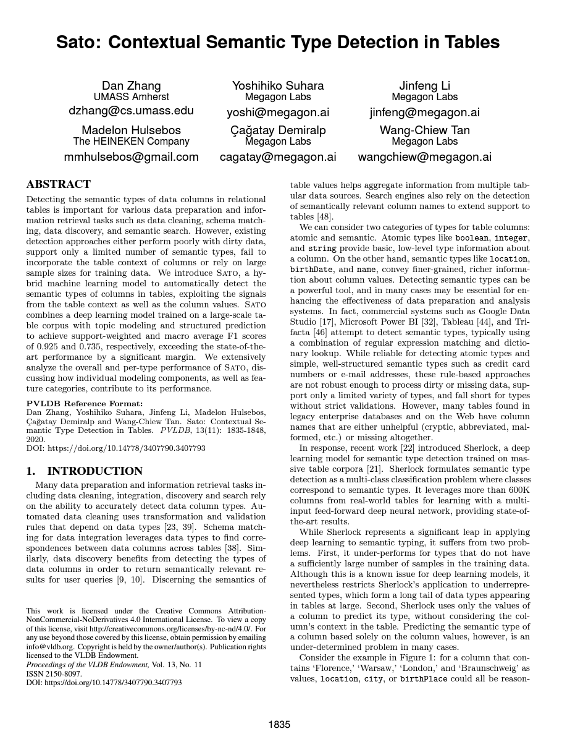
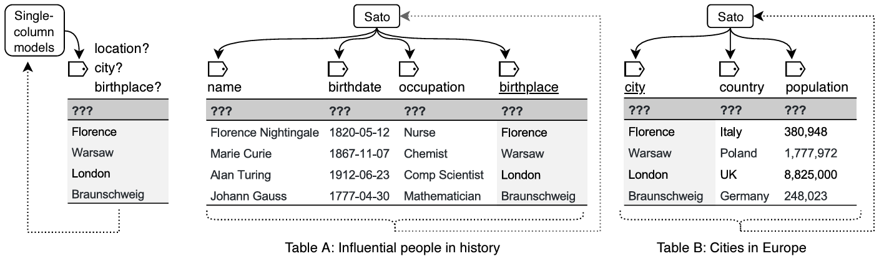
Semantic Data Type Detection
Schema Detection
[Dan Zhang et al:
Sato: Contextual Semantic Type Detection in Tables. PVLDB 2020]
Problem
Detect semantic types of columns with context
Use cases: improved data cleaning, schema matching via semantic types
SATO: LDA + DNN-based Type Detection
LDA model to estimate a table’s intent (global context)
Co-occurrence of columns (local context)
Sherlock for single column type prediction
Notes:
VizNet: 31 million datasets → corpus for auto visualization (CHI 2019)

Slide 17
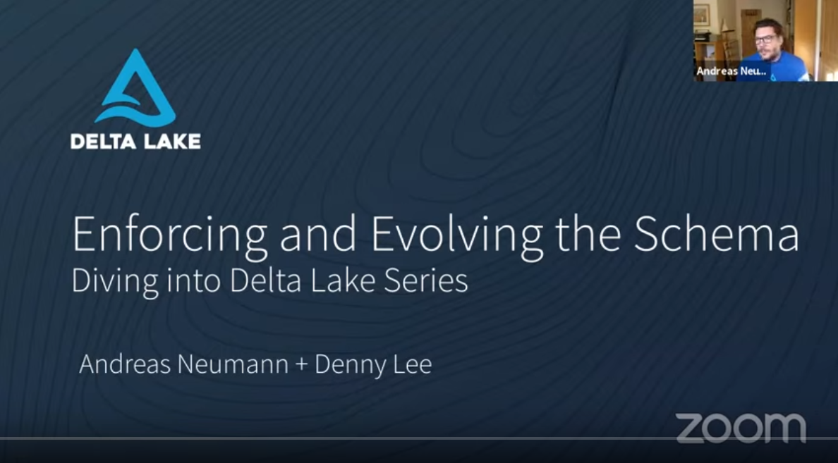
Schema Enforcement and Evolution
Schema Detection
Schema Enforcement
Given schema of syntactic and semantic types
#1 Raise errors on invalid data ingestion (ACID consistency and atomicity)
#2 Leverage schema constraints for automatic data cleaning
Schema Evolution
Incremental modification of schema
Handle changes of source data (additional columns, different data types)
Copy vs. in-place modifications (e.g., data type int → string)
Example: Delta Lake
[Andreas Neumann, Denny Lee: Enforcing and Evolving the Schema – Diving into Delta Lake Series, https://www.databricks.com/blog/2019/09/24/diving-into-delta-lake-schema-enforcement-evolution.html , 2019]

Slide 18
Schema Matching
Schema Detection
Schema Matching
Schema Mapping
INSERT INTO Orders SELECT BELNR, SUMME, DATUM FROM Bestellungen

Slide 19
Overview Schema Matching
Schema Matching
[Philip A. Bernstein, Jayant Madhavan, Erhard Rahm: Generic Schema Matching, Ten Years Later. PVLDB 2011 (test of time award)]
Motivation
Large and convoluted schemas (# tables, # attributes, structure)
Goal: generation of matching candidates (refined by user)
Problem Definition
Given: two schemas S1 and S2
Goal: Generate correspondences between S1 and S2
Correspondence: relationship between M elements in S1 and N elements in S2
Mapping expression: function how elements are related (directional or non-directional)
S2
BookInfo
ID | CHAR(15) PK
AuthorID | INT REF AuthorInfo
BookTitle | VARCHAR(128)
ListPrice | FLOAT
DiscPrice | FLOAT
S1
Books
ISBN | CHAR(15) PK
Title | VARCHAR(96)
Author | VARCHAR(64)
Price | FLOAT
AuthorInfo
AuthorID | INT PK
LastName | VARCHAR(32)
FirstName | VARCHAR(32)

Slide 20
System Architecture and Matching Process
Schema Matching
External
Schemas
Model Pool
[Erhard Rahm, Hong-Hai Do David Aumueller, Sabine Massmann: Matching Large Schemas with COMA++, 2005]
Mapping Pool
S₁
Att1 | Att2 | Att3
S₁
Mappings
Att4 | Att5
Att1 | Att2 | Att3
DAG IR
S₂
S₂
Mapping Manipulation
Matcher Configs
Matcher 1
matcher
{S₁₁,S₁₂,…}
S₁₁ ↔ S₂₁
S₁₂ ↔ S₂₂
S₁₃ ↔ S₂₃
Matcher 2
S₁
{S₂₁,S₂₂,…}
Matcher 3
S₂
Component Identification
Matcher Execution
Similarity Combination
Correspon- dences
Notes:
Notes: components (nodes, paths), matcher library (name, children, leafs), combination library (aggregation, selection, combined sim), mapping manipulation (diff, intersect, union, etc)

Slide 21
Classification of Matching Techniques
Schema Matching
Cardinalities: 1:1, 1:N, N:M
Combined Matchers (hybrid, composite)
Schema-based
Instance-based
Element
Structure
Element
Linguistic
Constraints
Constraints
Linguistic
Constraints
Name sim, description sim
Type sim, key properties
parent-child, graph structure
Word freq, key terms
Value patterns and ranges
[Erhard Rahm, Philip A. Bernstein: A survey of approaches to automatic schema matching. VLDB J. 2001]

Slide 22
Selected Matchers
Schema Matching
Schema Matching
Schema-based
Instance-based
Linguistic Approaches
Syntactic
Affix (suffix, prefix)
N-grams
EditDistance
Semantic
Synonyms
Hierarchy → taxonomies
Language → dictionaries
Example Trigram
Similarity = 2|S1 ∩ S2| / (|S1|+|S2|) = 8/16 = 0.5
Name | Street | City
Emma Schmidt | Luisenstrasse 90 | Munich, 80333
Klaus Schumann | Koenigsstrasse 7 | Dresden, 01199
Firstname | Lastname | Street | Num | ZIP | City
Susanne | Froehlich | Weststrasse | 2 | 01187 | Dresden
Thomas | Kunze | Dammweg | 45 | 12437 | Berlin
Name |  |  |  |  | __N | _Na | Nam | ame | me_ | e__
Lastname | __L | _La | Las | ast | stn | tna | nam | ame | me_ | e__
(alignment irrelevant)

Slide 23
Selected Matchers, cont.
Schema Matching
Schema Matching
Schema-based
Instance-based
Constraint-Based Approaches
Elements: data types, domains, key attributes, constraints
Structure: relationships between elements, combinations of data types, neighborhood, specialization and composition
Example Similarity Flooding
Create map pairs A x B (PCG)
Propagation coefficients: 1/|out(v)| (IPG)
Initial sim, adjusted by neighborhood sim until fixpoint (converged)
[Sergey Melnik, Hector Garcia-Molina, Erhard Rahm: Similarity Flooding: A Versatile Graph Matching Algorithm and Its Application to Schema Matching. ICDE 2002]
Notes:
PCG: pairwise connectivity graph
(if a is similar to b, then a1 is similar to b1; based on edges and labels)
IPG: induced propagation graph
(init, then sum of neighbors divide by max)

Slide 24
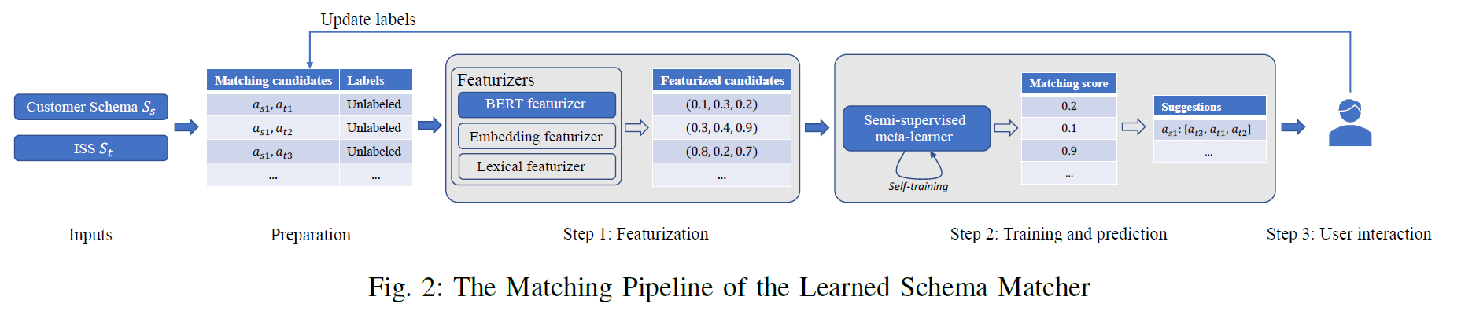
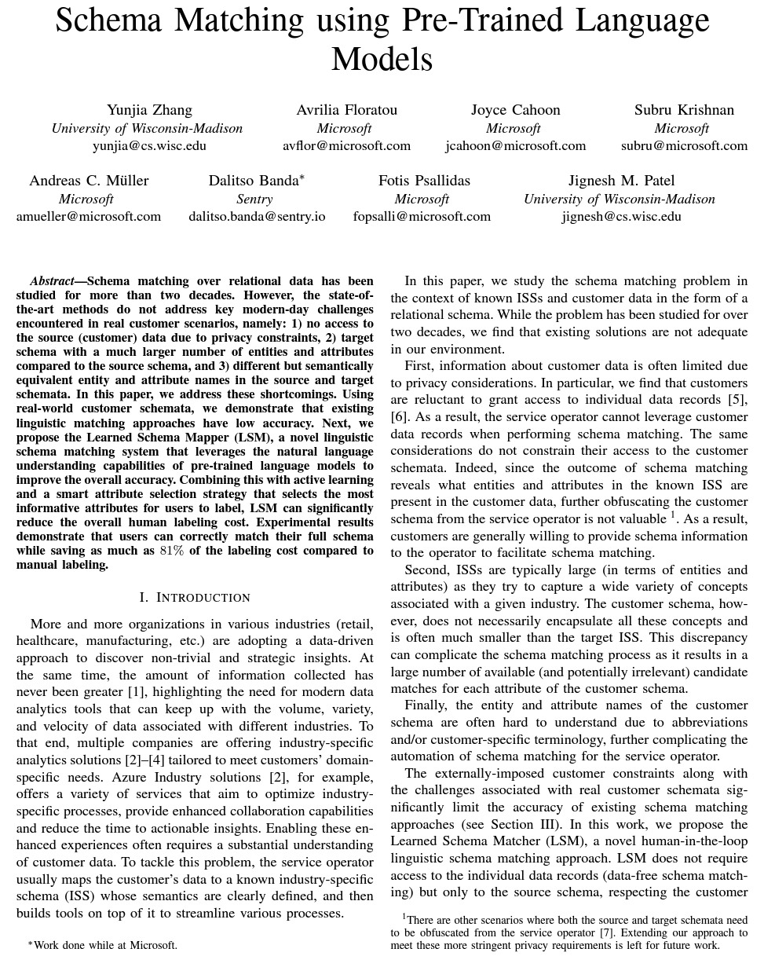
Selected Matchers
Schema Matching
Schema Matching
Schema-based
Instance-based
Pre-Trained Language Models
Standard Practice: Customer’s data to a known industry-specific schema (ISS)
Limitations: Data privacy (no access to data records), Large ISSs
Active learning for labeled input
Use pre-trained language model BERT to extract features
[Yunjia Zhang et. al:
Schema Matching using Pre-Trained Language Models. ICDE 2023]

Slide 25
Selected Matchers, cont.
Schema Matching
Schema Matching
Schema-based
Instance-based
Problem Schema-based
Attribute names might differ vastly (CustNa vs Name, CustSt vs Street)
➔ Instance-based matching, but need for data
Linguistic Approaches
Word frequencies, bigrams, trigrams, etc
Keywords, abbreviations
Constraint-based Approaches
Elements: data types and lengths, value domains, patterns
Structure: combinations of element constraints
Street | City
Luisenstrasse 90 | Munich, 80333
Koenigsstrasse 7 | Dresden, 01199
Street | Num | ZIP | City
Weststrasse | 2 | 01187 | Dresden
Dammweg | 45 | 12437 | Berlin
City
Munich, 80333
Dresden, 01199
5-letter numeric codes
ZIP
01187
12437

Slide 26
Combination of Matchers
Schema Matching
#1 Reuse
Exploitation of transitive similarity
Fast and efficient matching, but potential for lost mappings (e.g., S3 misses attributes)
#2 Refinement
Chaining: matcher M_{n+1} works on mappings of M_{n} ➔ efficiency but potential for lost mappings
Context-sensitive matching: Matching context of schema components, matching elements within components
#3 Composite Matchers
Select combination of complementary matchers in form of ensemble
Aggregation of similarity (e.g., trigram, synonym → avg/min/max)
S1 ≅ S3 ∧ S3 ≅ S2 → S1 ≅ S2
Matcher 1
Matcher 2
Matcher 1
Matcher 2
Combiner
Matcher 3

Slide 27
Efficiency and Scalability
Schema Matching
[Philip A. Bernstein, Jayant Madhavan, Erhard Rahm: Generic Schema Matching, Ten Years Later. PVLDB 2011]
Problem
Large schemas and matching complexity; all-pair problem O(n*m)
#1 Early Search Space Pruning
Faster matchers used to eliminate unlikely matches
Reduce schema sizes for expensive matchers
#2 Partition-based Matching
Blocking into independent fragments
Match elements of similar fragment
#3 Parallel Matching
Process different steps/fragments in parallel
#4 Custom Similarity Matrices
Sparse matrices (adjacency lists) w/ nesting
Divide & Conquer
1
1
1
2
3
3
2
1
2
[Philip A. Bernstein, Sergey Melnik, Michalis Petropoulos, Christoph Quix: Industrial-Strength Schema Matching. SIGMOD Record 2004]

Slide 28
Schema Matching Tools
Schema Matching
Commercial Tools
Most message-oriented middleware, EAI, ETL tools provide mapping UIs (w/ basic string similarity for matching)
Many data modeling tools also support matching/mapping
Academic Prototypes
[Erhard Rahm: Towards Large-Scale Schema and Ontology Matching. Schema Matching and Mapping 2011]

Slide 29

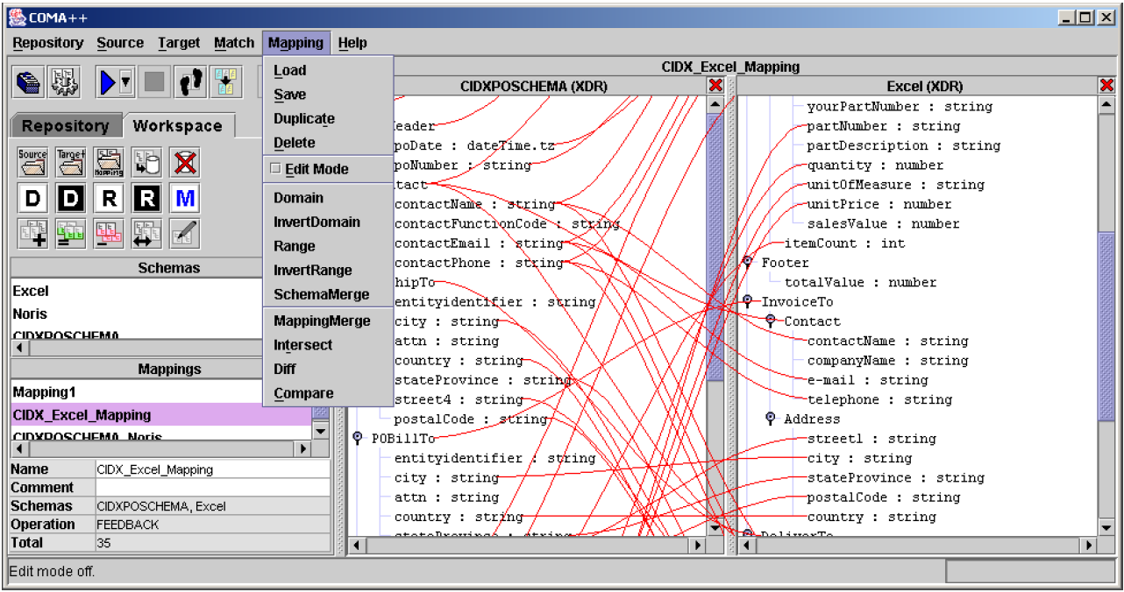
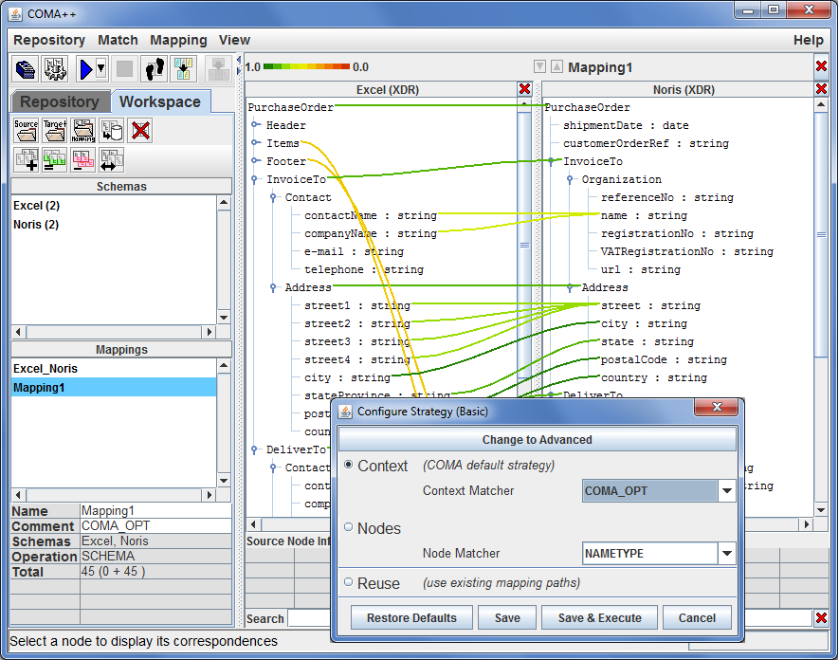
Schema Matching Tools, cont.
Schema Matching
COMA system for combining match algorithms in a flexible way)
COMA ++
COMA 3.0
2011/2012
Ontology Merging
Workflow Management
[Hong Hai Do, Erhard Rahm: COMA - A System for Flexible Combination of Schema Matching Approaches. VLDB 2002]
[David Aumueller, Hong Hai Do, Sabine Massmann, Erhard Rahm: Schema and ontology matching with COMA++. SIGMOD 2005]
[Credit: https://dbs.uni-leipzig.de/ de/Research/coma.html]

Slide 30
Schema Mapping
[Felix Naumann: Informationsintegration – Schema Mapping, HPI Lecture, 2012]
Schema Detection
Schema Matching
Schema Mapping
INSERT INTO Orders SELECT BELNR, SUMME, DATUM FROM Bestellungen
Notes:
TODO

Slide 31
Schema Mapping Overview
Schema Mapping
Problem
Given: two schemas w/ high-level mapping
Generate concrete transformation program/query (SQL, XSLT, XQuery)
Schema Mapping Process (systematic lowering)
High-level mapping: intra- and inter-schema correspondences
Low-level mapping: mapping that ensures consistency with constraints of target schema and user intend (interpretation)
Transformation query: transformation program from one into the other schema, backend-specific (query generation)
Example
Article
artPK
title
Publication
pubID
title
date
Transformation Query:
INSERT INTO Publication SELECT artPK, title, NULL FROM Article

Slide 32

Mapping Interpretations
Schema Mapping
Without Intra-Schema Correspondences
INSERT INTO Publication (SELECT artPK AS pubID, title AS title,
NULL AS date,
NULL AS author FROM Article)
UNION ALL
(SELECT NULL AS pubID,
NULL AS title,
NULL AS date,
name AS author
FROM Author)
Article
artPK
title
pages
Publication
pubID
title
date
author
Author
artFK
name

Slide 33
Mapping Interpretations, cont.
Schema Mapping
With Intra-Schema Correspondences
INSERT INTO Publication SELECT artPK, title, NULL, name
FROM Article, Author
WHERE artPK = artFK
Article
artPK
title
pages
Publication
pubID
title
date
author
Note: Inner join acts as filter (no articles w/o authors, NOT NULL constraints)
Author
artFK
name
INSERT INTO Publication SELECT artPK, title, NULL, name FROM Article LEFT OUTER JOIN Author
ON artPK = artFK

Slide 34
Mapping Interpretations, cont.
Schema Mapping
From Denormalized to Normalized Form
Skolem Function (SK): unique key generation from tuple values t[X] of an attribute set X
Publication
title
date
author
Article
artPK
title
pages
INSERT INTO Article SELECT DISTINCT SK(title), title, NULL FROM Publication
Author
artFK
name
INSERT INTO Author SELECT SK(title), author FROM Publication

Slide 35
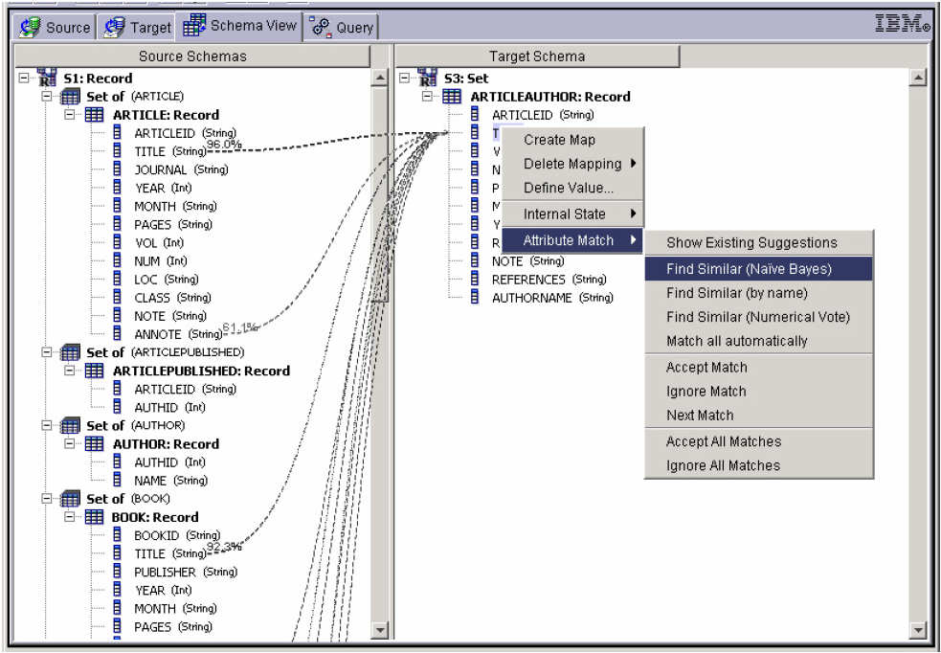
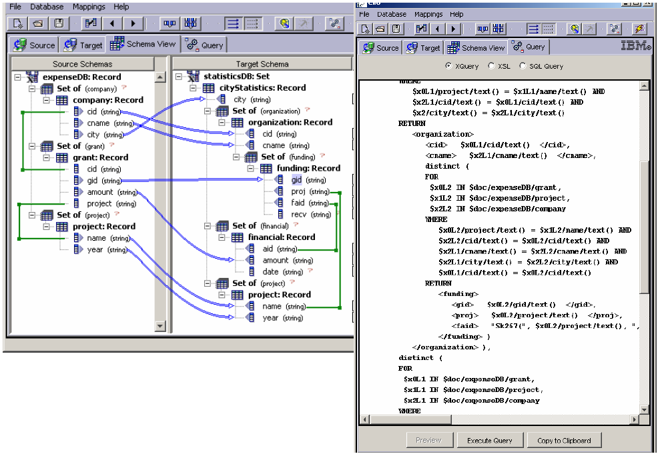
Schema Matching Tools
Schema Mapping
Clio (IBM Research – Almaden)
[Mauricio A. Hernández, Renée J. Miller, Laura M. Haas: Clio: A Semi-Automatic Tool For Schema Mapping. SIGMOD 2001]
[Laura M. Haas, Mauricio A. Hernández, Howard Ho, Lucian Popa, Mary Roth: Clio grows up: from research prototype to industrial tool. SIGMOD 2005]

Slide 36
Summary and Q&A
[Philip A. Bernstein, Sergey Melnik: Model Management 2.0: Manipulating Richer Mappings. SIGMOD 2007]
Schema Detection
Schema Matching
Schema Mapping
Next Lectures
05 Entity Linking and Deduplication [Nov 15]
06 Data Cleaning and Data Fusion [Nov 22]
“Given the existence of all these tools, why is it still so labor-intensive to develop engineered mappings? To some extent, it is an unavoidable consequence of ambiguity in the meaning of the data to be integrated. If there is a specification of the schemas, it often says little about integrity constraints, units of measure, data quality, intended usage, data lineage, etc. Given that the specification of meaning is weak and the mapping must be precisely engineered, it seems hopeless to fully automate the process anytime soon. A human must be in the loop.”
The 80% Argument

